Slide 1
Approximating solutions to systems of higher-order initial-value problems

Slide 2
Introduction
In this topic, we will
Discuss converting systems of higher-order initial-value problems into a system of 1st-order initial-value problems
Look at an example

Slide 3
System of two 2nd-order initial-value problems
We will show this by example:
This requires four initial conditions:

Slide 4
System of two 2nd-order initial-value problems
We will represent:
We can immediately translate the initial conditions:

Slide 5
System of two 2nd-order initial-value problems
We also immediately note that:
That leaves us with determining

Slide 6
System of two 2nd-order initial-value problems
Thus, we have:
We can write this as a function:
vector f( double t, vector w ) {
return vector{ 4, (double[]){
w(1),
std::sin(t) - 2*w(1) - w(0) - w(2),
w(3),
std::cos(t) - w(3) - w(2) - w(0)
} };
}

Slide 7
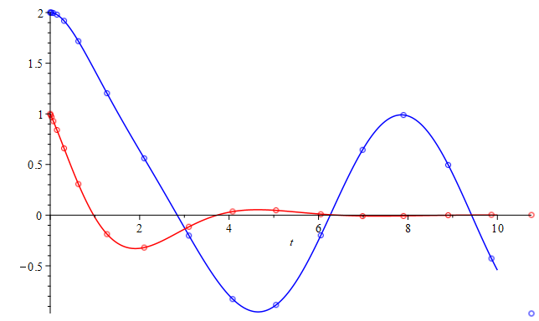
System of two 2nd-order initial-value problems
Plotting the actual solution versus the

Slide 8
System of two 2nd-order initial-value problems
0 < 1 -1 2 0 >
0.01 < 0.9899507 -1.0098008 1.9999005 -0.0198502>
0.03 < 0.9695678 -1.0282224 1.9991135 -0.0586547>
0.07 < 0.9277737 -1.0604838 1.9952704 -0.1327130>
0.15 < 0.8408958 -1.1077690 1.9791628 -0.2669310>
0.31 < 0.6599369 -1.1418081 1.9182831 -0.4828253>
0.63 < 0.3072558 -1.0298129 1.7176558 -0.7357848>
1.27 <-0.1870949 -0.4857930 1.2033141 -0.8119151>
2.1015668 <-0.3197583 0.0966596 0.5615785 -0.7482154>
18 3.1015668 <-0.1142981 0.2232183 -0.2015183 -0.7630420>
4.0791478 < 0.0363239 0.0711120 -0.8282826 -0.4258318>
5.0504978 < 0.0478470 -0.0300383 -0.8858265 0.3398003>
6.0504978 < 0.0094451 -0.0317667 -0.1990892 0.9286665>
6.9858539 <-0.0096116 -0.0052132 0.6446146 0.7403237>
7.9002755 <-0.0081134 0.0075244 0.9883434 -0.0443953>
8.9002755 <-0.0001790 0.0047968 0.4956264 -0.8559776>
9.8671404 < 0.0035653 -0.0015659 -0.4269945 -0.8992590>
10.762308 < 0.0023111 -0.0031120 -0.9703157 -0.2322476>

Slide 9
Other systems higher-order initial-value problems
Thus, if we had four coupled odes:
This requires eleven initial conditions
This would require us to define a system of eleven 1st-order initial-value problems

Slide 10
Other systems higher-order initial-value problems
Thus we would reformulate as follows:

Slide 11
Summary
Following this topic, you now
Understand how to convert a system of higher-order initial-value problems into a system of 1st-order initial-value problems
Have seen an example and its solution

Slide 12
References
[1] https://en.wikipedia.org/wiki/Initial_value_problem

Slide 13
Acknowledgments
None so far.

Slide 14
Colophon
These slides were prepared using the Cambria typeface. Mathematical equations use Times New Roman, and source code is presented using Consolas. Mathematical equations are prepared in MathType by Design Science, Inc.
Examples may be formulated and checked using Maple by Maplesoft, Inc.
The photographs of flowers and a monarch butter appearing on the title slide and accenting the top of each other slide were taken at the Royal Botanical Gardens in October of 2017 by Douglas Wilhelm Harder. Please see
https://www.rbg.ca/
for more information.

Slide 15
Disclaimer
These slides are provided for the ece 204 Numerical methods course taught at the University of Waterloo. The material in it reflects the author’s best judgment in light of the information available to them at the time of preparation. Any reliance on these course slides by any party for any other purpose are the responsibility of such parties. The authors accept no responsibility for damages, if any, suffered by any party as a result of decisions made or actions based on these course slides for any other purpose than that for which it was intended.

